Slide 1
ITORETOT project
Summary presentation

Slide 2
Achievements
One web application which bundle all the movement data.
Perception WP website
Web application
Members
Projects
Tasks
Events

Slide 3
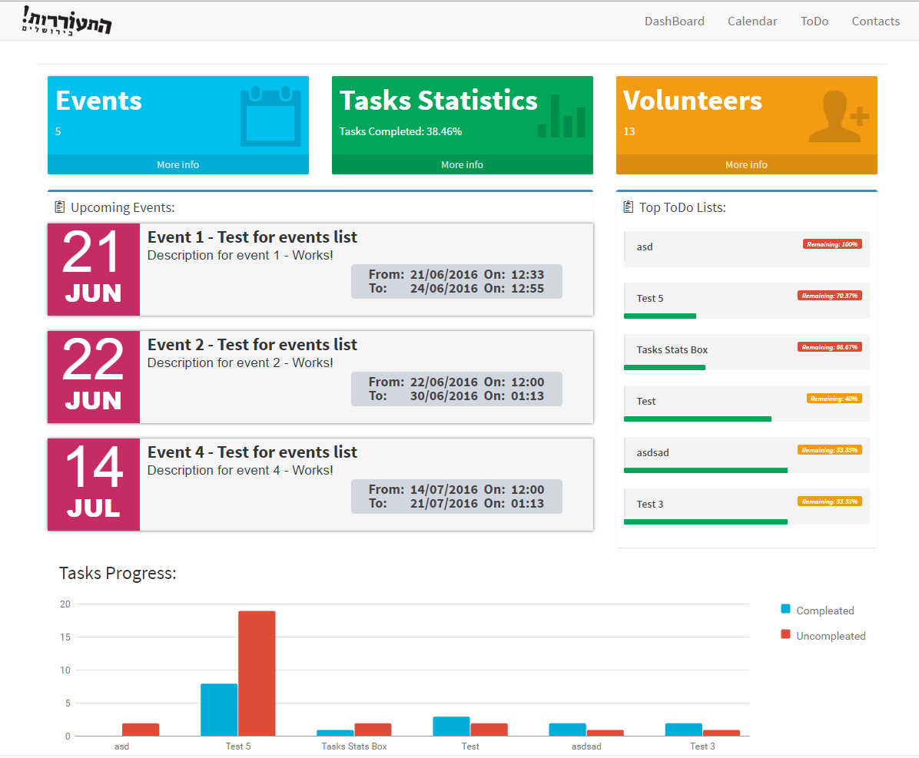
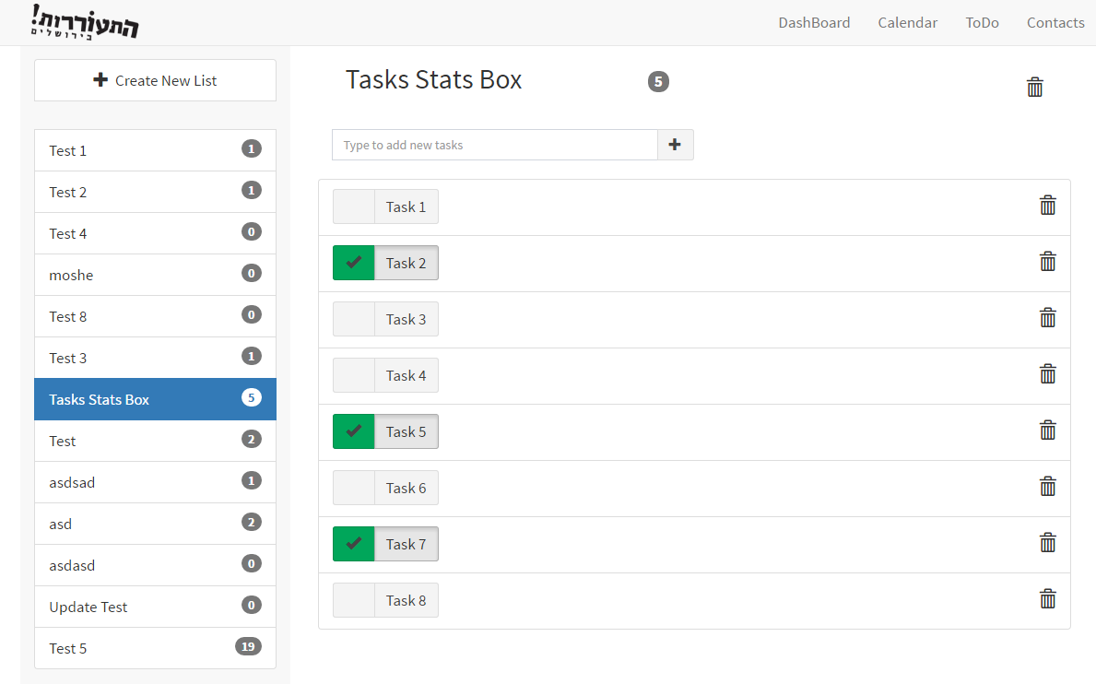
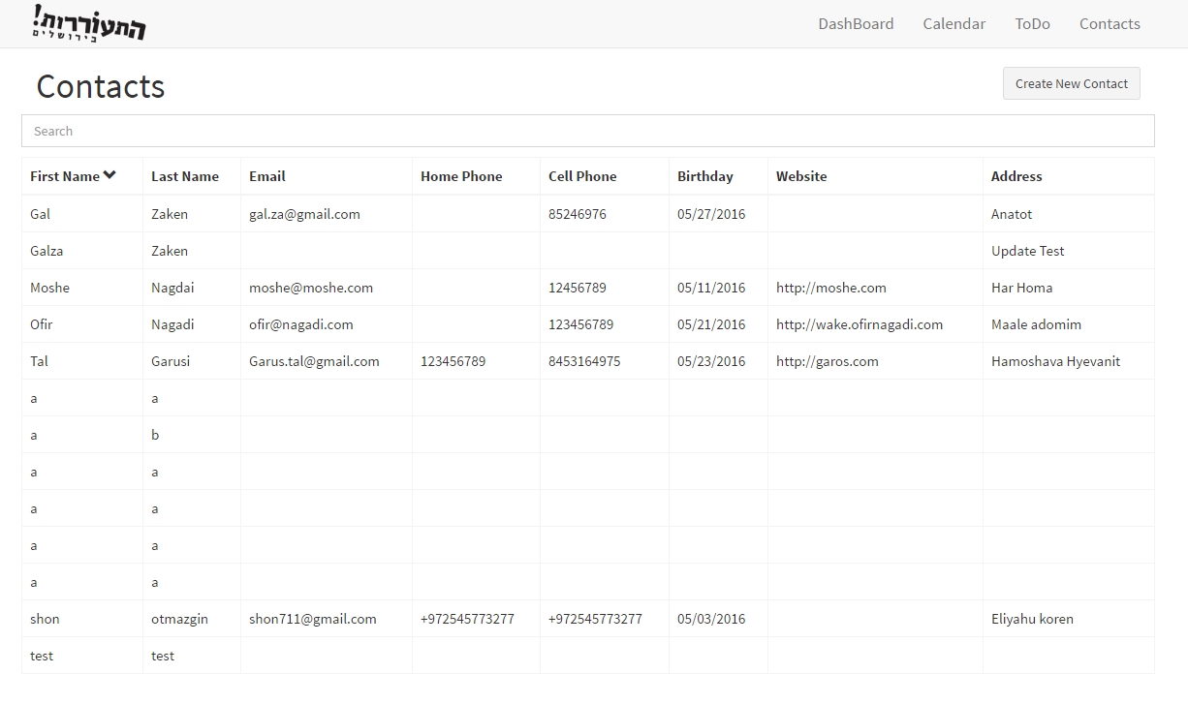
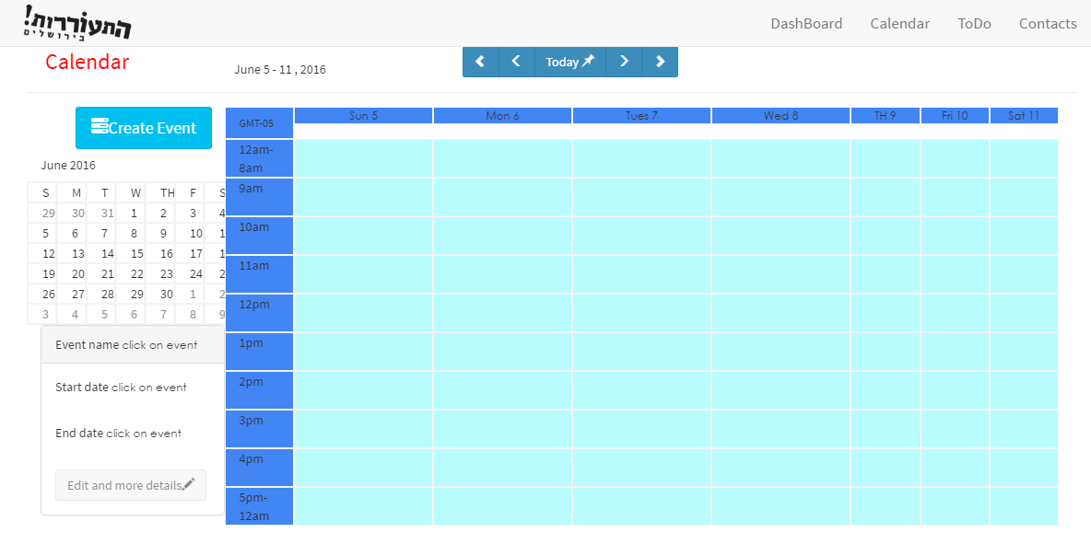

Slide 4


Retrospective
Successful teamwork
The SRS sprint is a critical step in the project, all the team should know and be part of this sprint.
The design sprint should be detailed and modularly, it is good to open it with a team brain storm.
The client should be part of the development environment, many features and improvements can be achieve with that attitude.
Customer orientation
Development
Testing
Release
Client review
Documentation
Fast development solutions

Slide 5
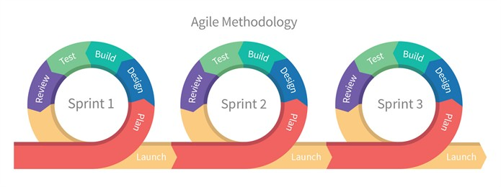
Methods and Tools
Agile
Team meeting
Client review
Unit test
High detailed documentation
MEAN stack Development

Slide 6
Security
Due to fast develop, the information security of the app is low.
All the DB queries is in clear text.
Using HTTP instead SSH to transfer data between server and client.
The application stores sensitive information about the movement.
Information security features should be part of the application.

Slide 7
Review and documentation in Agile
Agree ?
X Disagree ?

